Slide 1
Value-Based Incentive Models and Overtreatment
Geetanjali Gupta

Slide 2

Agenda
Executive Summary
Incentivizing Quality and Necessity
Background
Evolution of Incentives and Overtreatment
Successes, Failures, Challenges
Recommendation 1
Supporting Analysis
Recommendation 2
Supporting Analysis
Notes:
Overtreatment

Slide 3
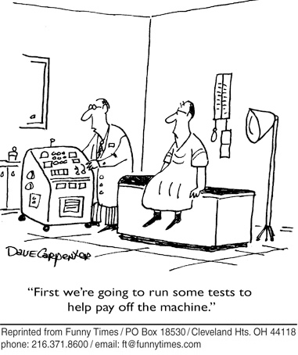
Executive Summary:
Balancing Incentives to Limit Overtreatment
Factors that drive physician income can also influence physician behavior
In the fee for service model, each additional service a practice provides can mean additional profit, leading to overtreatment
Clinical appropriateness remains difficult to measure due to biases
Preventing Overtreatment
Implement a value-based incentive model combined with the quality grants model
Value should be based on collaborative effort and the holistic outcome for patient
Adaptive value and multi-faceted incentives to align with complexity, and limit administrative burden in tracking care decisions

Slide 4
Evolution of Incentives and Overtreatment
BCBS Cost Plus reimbursement plan: Compensation "reasonable and customary charges" self-set, hospitals reimbursed as percentage of actual costs and working capital Limited cost moderation
Congress created the Medicare and Medicaid programs to provide health care coverage to the elderly and low-income
.
1950-1964
1973
1940-1950
1965
Hospital care cost doubled with innovation boom: No external controls on the cost of medical therapies or the resources
The Health Maintenance Organization Act of 1973 was passed to encourage HMO growth in the marketplace. HMOs were able to reduce resource utilization rates, particularly hospital admissions and lengths of stay.
HITECH act was introduced which established programs under Medicare and Medicaid to provide incentive payments to eligible healthcare providers for the “meaningful use” of EHR systems
Medicare instituted a prospective payment system (PPS) for reimbursing hospitals
1992
2010
1983
2009
Reimbursements for Medicare calculated based on resource cost and consumption
The Affordable Care Act (ACA) emphasizes quality care and value-based programs that reward providers based on quality
Notes:
1940-1950
Cost Plus reimbursement plan by Blue Cross Blue shield was introduced. In this payment scheme, physicians were compensated according to "reasonable and customary charges" that they themselves set, and hospitals were reimbursed on a percentage of their actual costs plus a percentage of their working and equity capital. This allowed doctors to charge whatever they wanted and encouraged hospitals to increase costs so their cost-based income would be greater.
1950-1964
The price of hospital care doubled, and medical breakthroughs were coming at a fast pace. The health care system was fiscally unrestrained. There were no external controls on the cost of medical therapies delivered or the resources consumed.
1965
Congress created the Medicare and Medicaid programs to provide health care coverage to the elderly and poor
1973
The Health Maintenance Organization Act of 1973 was passed to encourage HMO growth in the marketplace. HMOs were able to reduce resource utilization rates, particularly hospital admissions and lengths of stay.
1983
Medicare instituted a prospective payment system (PPS) for reimbursing hospitals
1992
System for calculating reimbursements to physicians for services covered by Medicare was switched to one based on the cost of resources consumed in delivering a particular clinical service.
2009
HITECH act was introduced which established programs under Medicare and Medicaid to provide incentive payments to eligible healthcare providers for the “meaningful use” of EHR technology.
2010
The Affordable Care Act (ACA) was implemented which placed more emphasis on quality care and authorized a number of value-based programs that rewarded healthcare providers based on that quality rather than on quantity

Slide 5
Current Incentive Models
FINANCIAL INCENTIVE MODELS
1 | Quality Bonuses | Providers receive any applicable bonuses within an established period after performance is measured (~5-10% of salary)
2 | Compensation at Risk | The organization applying the incentive withholds some of the provider’s total compensation (~5-10% of salary) and retains it in an account where interest accrues
3 | Performance Fee Schedules | The organization that directly contracts with providers creates provider fee schedules linked to performance
4 | Quality Grants | An insurer, employer, or a coalition of these organizations releases a request for proposals (RFP) to physicians, medical groups, hospitals, and PHOs asking them to submit quality improvement (QI) proposals The organization that releases the RFP offers financial and administrative grant support to the winning providers or groups to pilot QI projects
5 | Reimbursement for Care Planning | Providers receive additional reimbursement for completing care planning tasks for people with chronic conditions, such as diabetes, asthma, congestive heart failure, and high blood pressure
6 | Variable Cost Sharing for Patients | Insurers or self-insured employers offer insurance products with three-tiered patient deductibles and co-pays for hospital admissions and for medical office visits
What model do you think physicians prefer most/least?
Notes:
http://www.bailit-health.com/articles/NHCPI-incentive-models.pdf
Insert zoom poll

Slide 6
Current Incentive Models
FINANCIAL INCENTIVE MODELS
1 | Quality Bonuses | Providers receive any applicable bonuses within an established period after performance is measured (~5-10% of salary)
2 | Compensation at Risk | The organization applying the incentive withholds some of the provider’s total compensation (~5-10% of salary) and retains it in an account where interest accrues
3 | Performance Fee Schedules | The organization that directly contracts with providers creates provider fee schedules linked to performance
4 | Quality Grants | An insurer, employer, or a coalition of these organizations releases a request for proposals (RFP) to physicians, medical groups, hospitals, and PHOs asking them to submit quality improvement (QI) proposals The organization that releases the RFP offers financial and administrative grant support to the winning providers or groups to pilot QI projects
5 | Reimbursement for Care Planning | Providers receive additional reimbursement for completing care planning tasks for people with chronic conditions, such as diabetes, asthma, congestive heart failure, and high blood pressure
6 | Variable Cost Sharing for Patients | Insurers or self-insured employers offer insurance products with three-tiered patient deductibles and co-pays for hospital admissions and for medical office visits
Notes:
http://www.bailit-health.com/articles/NHCPI-incentive-models.pdf

Slide 7
Current Incentive Models
NON FINANCIAL INCENTIVE MODELS
7 | Performance Profiling | Performance is compared across similar providers, taking into account significant differences in volume and characteristics of patient populations that might affect provider performance. The profile reports are designed for physicians, not patients or stakeholders
8 | Publicizing Performance | Organizations publicly distribute information on provider performance and inform providers of their intent to do so in advance. Potential positive or negative publicity is used to motivate providers to improve performance
9 | Technical Assistance for Quality Improvement | Organization offers technical assistance to hospitals, medical groups, or individual providers to help them achieve quality improvements
10 | Practice Sanctions | Organization that contracts directly with providers measures provider performance on selected quality indicators annually
11 | Reducing Administrative Requirements | The organization evaluates the performance of providers on targeted measures. Those who meet a best practice threshold are not required to meet existing administrative requirements
Notes:
http://www.bailit-health.com/articles/NHCPI-incentive-models.pdf

Slide 8
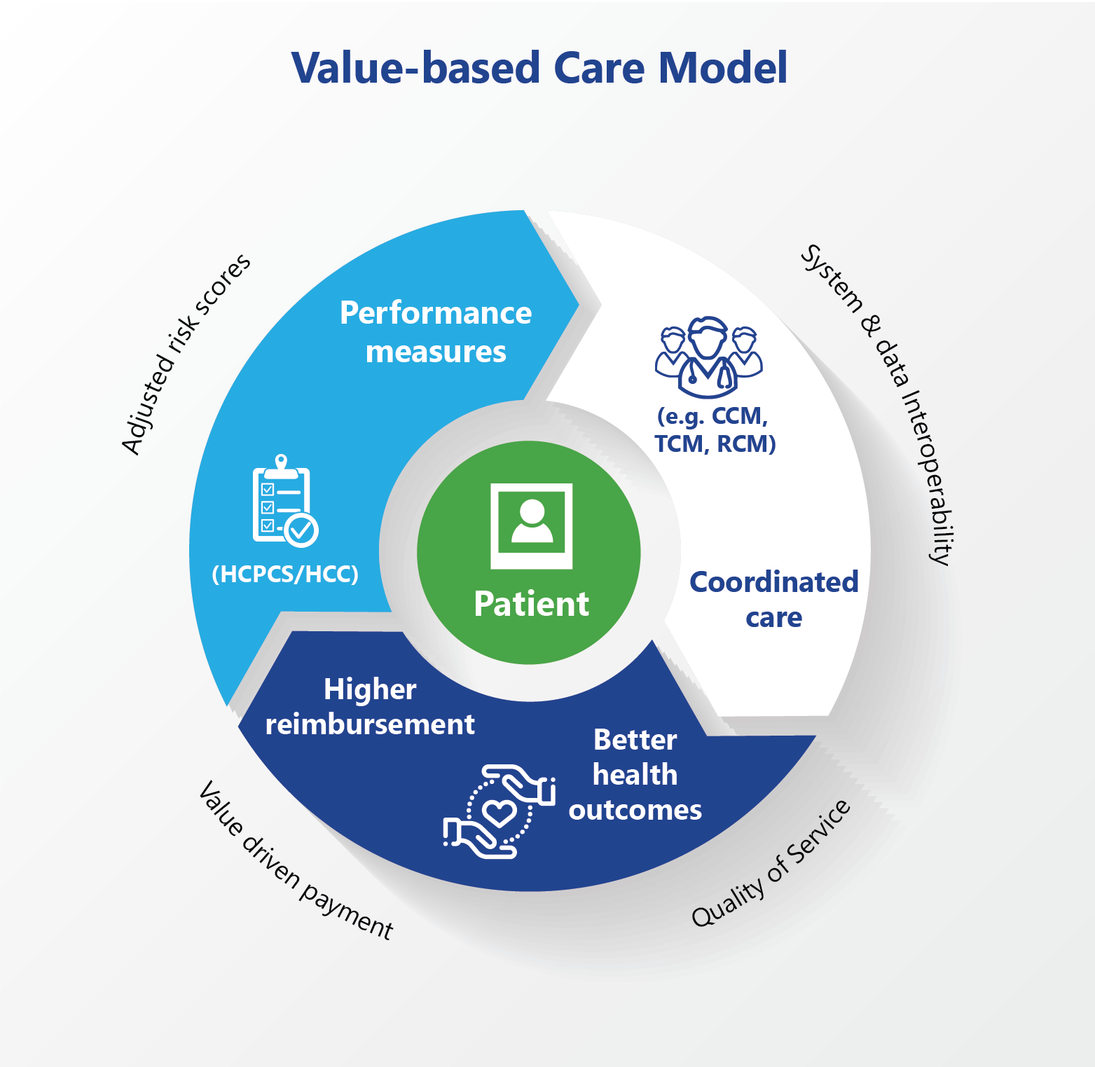
Success for Incentive Models
Value-Based Care
Improve quality and value focus
Increased connection to mission of healthcare
Patient and Organization Well-being
Improve patient safety and experience by reducing burnout
Aid organizations in achieving financial sustainability
Notes:
https://www.mgma.com/MGMA/media/files/fellowship%20papers/2019%20Fellows%20Papers/Development-and-Implementation-of-a-Staff-Incentive-Bonus-Program.pdf?ext=.pdf
https://www.who.int/workforcealliance/knowledge/publications/alliance/Incentives_Guidelines%20ENG%20low.pdf?ua=1

Slide 9

Misaligned Priorities Lead to Overtreatment
Overtreatment: Procedures or tests that are not medically necessary
Waste
Physicians are incentivized to over-treat
Unnecessary services are largest proportion in US
$210B of the estimated $750B in excess spending each year
Patient Impact
Physical and financial cost
Value incentivize focus on healthy, rich populations
Excess care on the insured
Decline in care for vulnerable, medically complex
OVERTREATMENT
No-value
procedures
Harm
Financial Burden
Equity Decrease
INCENTIVES
Financial Gain
(70.8%)
Litigation cost avoidance (84.7%)
Lack of Patient History
Overtreatment Waste:
20.6% of Care
PATIENT BEHAVIOR
Low Healthcare Literacy
Patient Demand (59.0%)
Notes:
25% medical tests, 22% prescription, 11% procedures
Another McKinsey report found that health care providers in the U.S. conduct far more CT tests per capita than those in any other country — 71% more than in Germany, for example, where the government-run health care system offers none of those incentives for overtesting. http://content.time.com/time/subscriber/article/0,33009,2136864-2,00.html
https://jamanetwork.com/channels/health-forum/fullarticle/2760210
https://hms.harvard.edu/news/pay-performance-fails-perform
https://www.statnews.com/2018/01/30/pay-for-performance-doctors-hospitals/
ttps://journals.plos.org/plosone/article?id=10.1371/journal.pone.0181970
simple cartoon physician

Slide 10
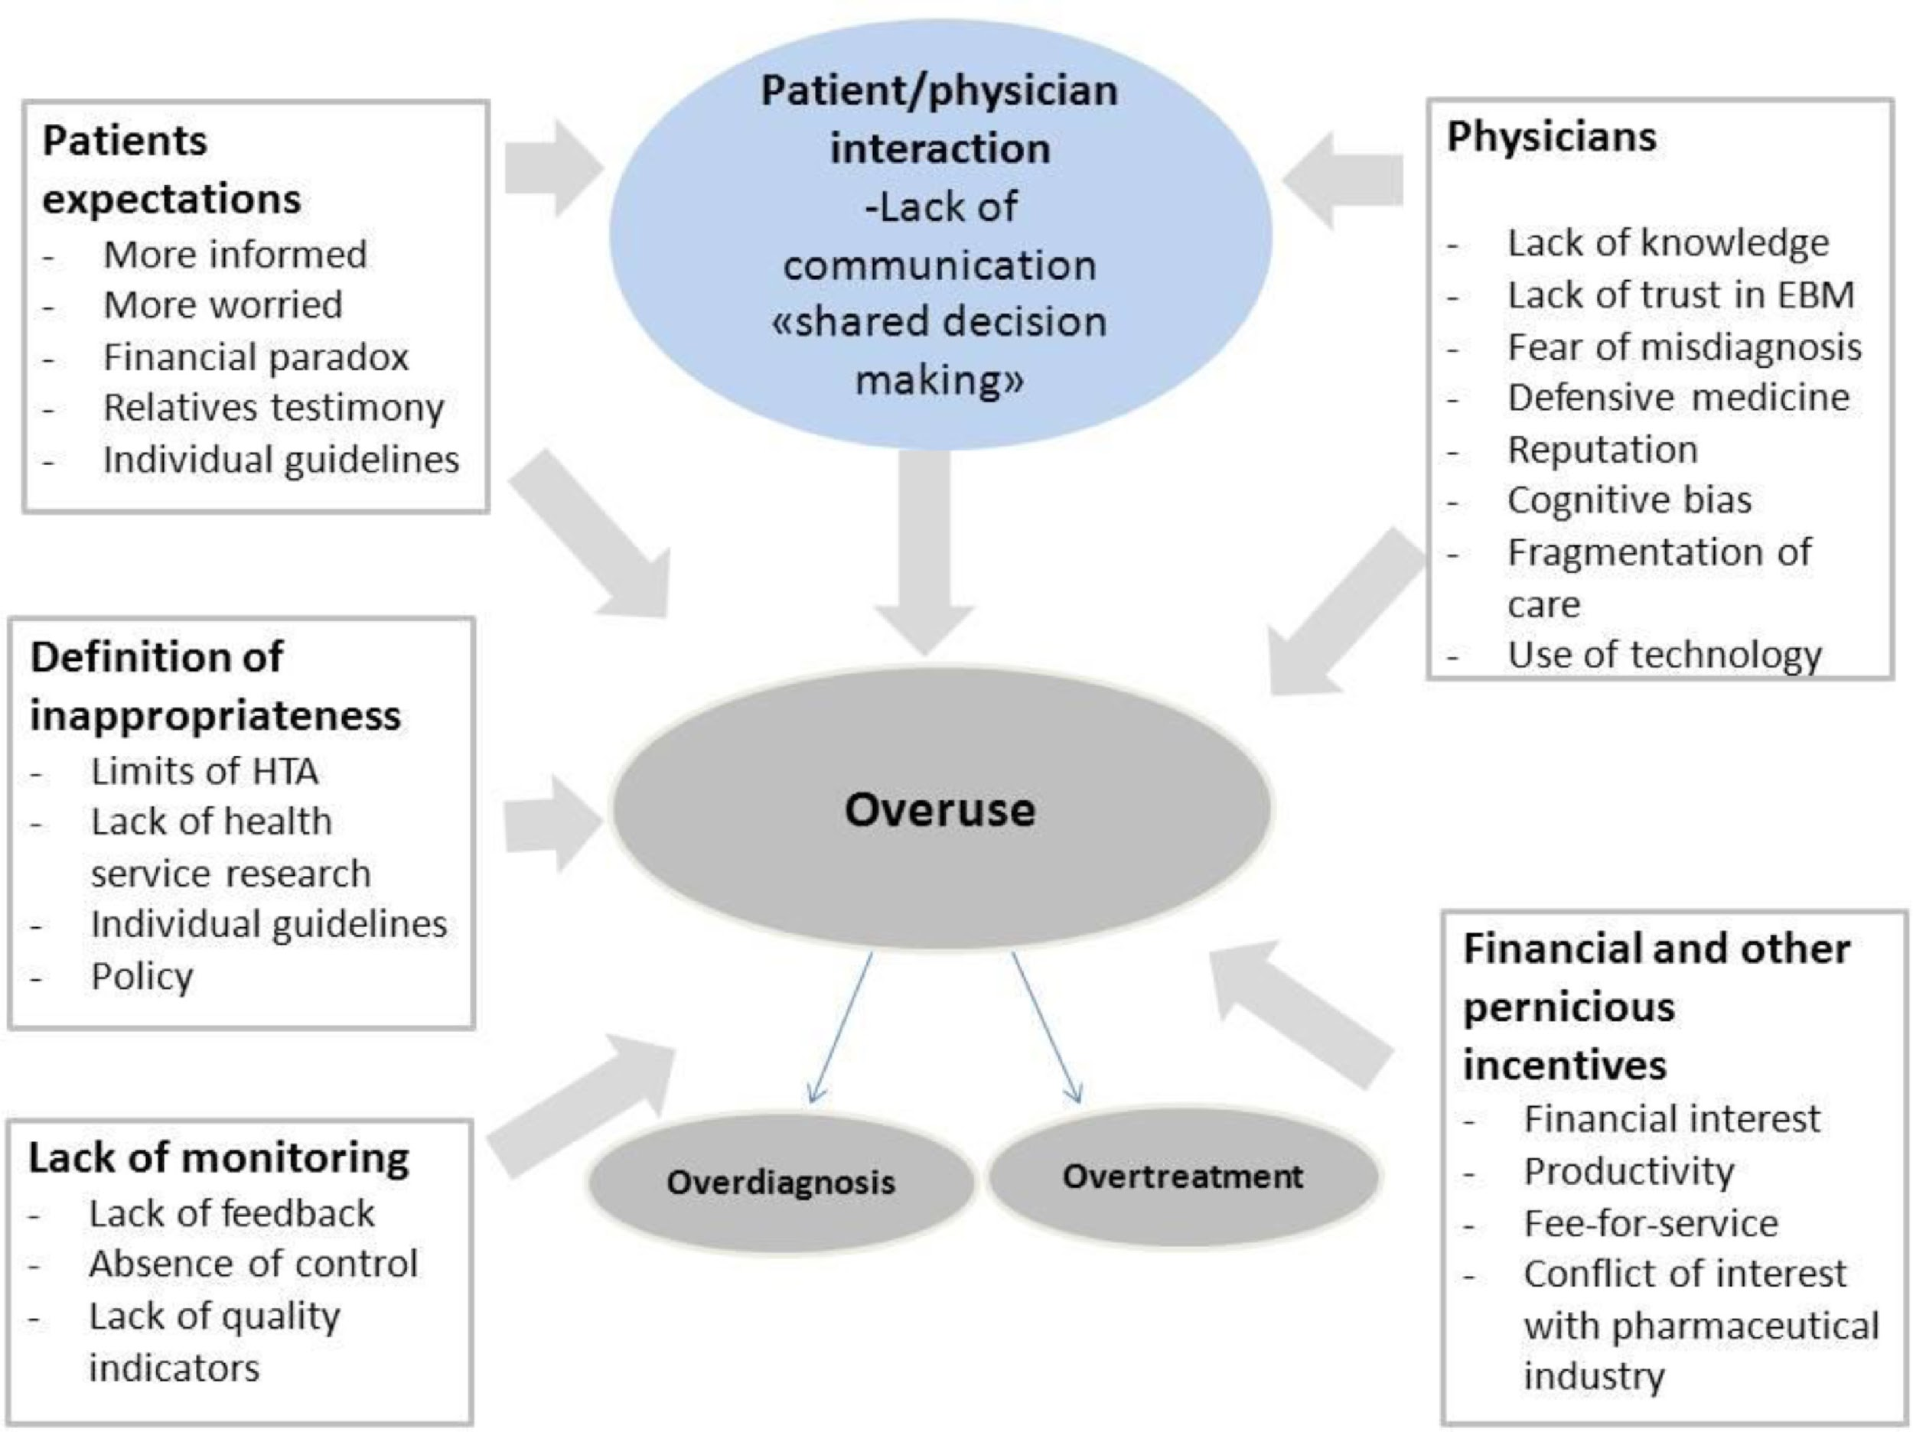
Notes:
https://www.ejinme.com/article/S0953-6205(20)30128-X/fulltext

Slide 11

There is No Simple Fix
Incentive Models
Not exclusive to FFS
Value-based care can incentivize overtreatment
Regional and enduring
Private insurance
Medicare
Attributable in part to training
Mentors perform many tests, so will trainees
Incentive effectiveness dependent on context
No ‘one-size-fits-all’ solution
Insured patient demand
Desire to get value from insurance in absence of condition
Ex. Bias and disaparite use of C-Sections
Overtreatment
Training and Culture
Patient Influence
Notes:
https://www.ncbi.nlm.nih.gov/pmc/articles/PMC6498548/ regional
https://pubmed.ncbi.nlm.nih.gov/30229364/
https://www.hsrd.research.va.gov/publications/esp/pay-for-perf-REPORT.pdf
https://www.advisory.com/daily-briefing/2019/04/30/doc-overtreatment
https://www.npr.org/sections/health-shots/2019/04/19/715113208/why-do-doctors-overtreat-for-many-its-what-they-re-trained-to-do
2017-06-health-overtreatment.html

Slide 12
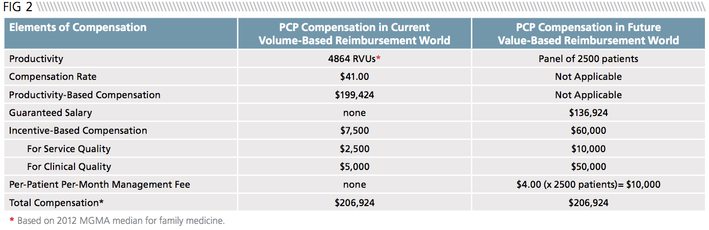
Value + Quality Grant-Based Incentive Model
Recommendation 1:
Implement a value-based incentive model with a large emphasis on the quality grants model
Private Insurers should invest more in the value-based incentive model
Performance bonuses to reward providers for meeting predefined thresholds for quality care
Quality grants help deter physicians from focusing on solely “healthy populations” and can encourage investments in preventative care
Notes:
https://www.bcg.com/en-us/publications/2019/paying-value-health-care
https://www.bdcadvisors.com/wp-content/uploads/2015/08/ROADMAP_FOR_PHYSICIAN-COMPENSATION-IN-A-VALUE-BASED-WORLD.pdf
Currently BCBS is one of the most invest private insurers

Slide 13
Value + Quality Grant-Based Incentive Model
When it comes to changing behavior, financial incentives matter—but so do organizational cultures, norms, practices, and data and analytics
CMS - Successful Medicare and Medicaid Incentives
Shift to population health management
Promotes interoperability
Health systems should encourage physicians and practices to apply for quality grants
Challenges:
No single value-based payment model is appropriate for all situations or all patient groups
Especially challenging for specialists
Existing Medicaid/Medicare VB Incentive Programs:
End-Stage Renal Disease Quality Incentive Program (ESRD QIP)
Hospital Value-Based Purchasing (VBP) Program
Hospital Readmission Reduction Program (HRRP)
Value Modifier (VM) Program (also called the Physician Value-Based Modifier or PVBM)
Hospital Acquired Conditions (HAC) Reduction Program
Skilled Nursing Facility Value-Based Program (SNFVBP)
Home Health Value Based Program (HHVBP)
Notes:
https://michiganhpf.msu.edu/index.php/2-uncategorised/28-six-serious-problems-with-value-based-purchasing

Slide 14
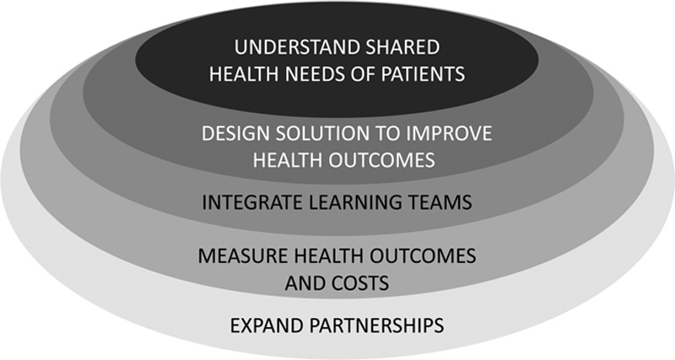
Choosing the right Value-Based Incentive Program for a healthcare system
Transition requires physicians to think about their role differently
Solutions to encourage adoption
Change medical school curriculum (ex. master’s degree in health care transformation)
Expand partnerships with other clinical organizations
Why is interoperability and IT integration are important when implementing value-based programs?
Framework of Value-Based Healthcare
Notes:
https://www.cms.gov/Medicare/Quality-Initiatives-Patient-Assessment-Instruments/Value-Based-Programs/Value-Based-Programs
https://journals.lww.com/academicmedicine/fulltext/2020/05000/defining_and_implementing_value_based_health_care_.14.aspx

Slide 15
Leverage Performance Profiles in Value-Based Model
Recommendation 2:
Redefining and Measuring Value
Value based on collaborative effort and holistic outcome for patient:
Value = Necessity + Outcome - Administrative Burden
Utilizing Regional and Population Data for Improvement
Physician dashboard consolidates their care decisions through a scribe
Value-based care
Dashboard profile - Administrative Burden
Treatment when needed
Patient-centric focus, Increase communication and transparency
Discourage financial incentives for over-treatment
Patients receive care when necessary, Physicians are motivated by patient health, and less paperwork
Notes:
Combine value-based care with an adjusted compensation model and collaborative and competitive culture around providing the best care at the lowest cost Collaborative transparencyP ersonal procedure use scores Tie some incentives to group success in patient outcome: Did the team give their best effort? Was a certain perspective ignored? Bonus structure based on team outcome (partial)
https://www2.deloitte.com/us/en/blog/health-care-blog/2020/value-based-care-is-more-likely-to-succeed-if-physician-compensation-models-change.html
https://www.advisory.com/daily-briefing/2019/04/30/doc-overtreatment
https://www.managedhealthcareexecutive.com/view/could-the-pandemic-put-an-end-to-medical-overtreatment-

Slide 16
Balanced Incentives
Patient Outcomes
Well-being of the patient considered at every step of care: Limit unnecessary, expedite necessary
1
Innovation
Recognize value in providing standardized care, or no care, not just new discoveries
2
Internal Performance
Leadership for culture collaborative, balanced care
Physician Dashboard: Performance Profile enables personal “audit” of care decisions against aggregated data for routine procedures in other regions
3
Financial
Value-based payment with adjustments for vulnerable patients
4
Incentivizing for quality of care must be systemic to drive effective outcomes - not just financial

Slide 17
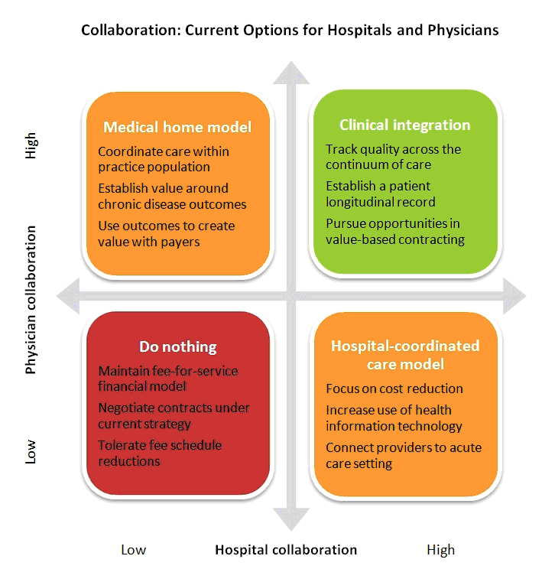
Multi-faceted Approach to Performance
Financial incentive models do not account for the complexity of care and outcomes
Incremental Implementation
Adjusted by type of care
Use data to guide rather than to penalize
Benefits
Continuous growth to avoid overtreatment habits
Collaborative care and performance profile limits patient exposure to unnecessary procedures
Value of care defined by reality of complex factors
Social determinants of health, type of care, and more
Lower stress for physicians due to conflicting priorities, and poor patient outcomes
Challenges
Ownership of outcomes drive performance, but only if the outcome is measured fairly
Notes:
https://www.4sighthealth.com/a-question-of-change-should-doctors-make-less-money/

Slide 18
Conclusions
Takeaways
Financial incentives significantly influence treatment decisions
Fee-for-service and flat salary models lack balance and drive overtreatment
Transition from fee-for-service to value-based care increases cost-effectiveness
Contributing factors and incentive-based solutions to overtreatment will vary
Different settings should adapt to best-suited incentives
Ex. Malpractice, patient demand, and the difficulty of accessing the medical records
Reducing Overtreatment
Shared decision-making
Multi-faceted incentive approach
Holistic patient care training
Improved data sharing and Interoperability accelerates the adoption of value-based care models by improving communication accuracy
This reduces the number of tests, procedures, and unnecessary patient visits
Notes:
Financial incentives significantly influence physicians supply of healthcare. Fee-for-service and flat salary models are the drivers of overtreatment.
Malpractice, patient demand, and the difficulty of accessing the medical records are the top reasons for overtreatment, and reduction in these services would impact the healthcare spending resulting in savings.
Shared decision-making, training on appropriateness criteria and practice guidelines can be used as tools to reduce overtreatment.
Successful transition from a fee-for-service model to value-based care leads to a cost-effective healthcare system because it removes the incentive to provide care that is duplicative or unnecessary.
Interoperability accelerates the adoption of value-based care models by increasing data access and sharing capabilities. Improved data sharing and interoperability of healthcare information can reduce the number of tests, procedures, and patient encounters.

Slide 19
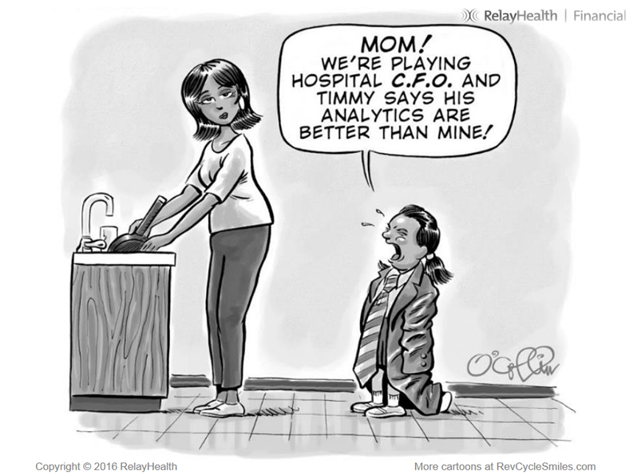
Thank You - Questions?

Slide 20
References
AMA Council on Ethical, & Affairs, J. (2013). AMA Code of Medical Ethics’ Opinions on Financial Incentives and Conflicts under Various Models of Payment for Care. AMA Journal of Ethics, 15(7), 581–586.
Lyu, H., Xu, T., Brotman, D., Mayer-Blackwell, B., Cooper, M., Daniel, M., Wick, E. C., Saini, V., Brownlee, S., & Makary, M. A. (2017). Overtreatment in the United States. PloS One, 12(9). https://doi.org/10.1371/journal.pone.0181970
Boston University. (2017, October 12). A Treatment for Overtreatment? | The Brink. http://www.bu.edu/articles/2017/overtreatment/
M. (2013, March 4). Bitter Pill: Why Medical Bills Are Killing Us. TIME.Com. http://content.time.com/time/subscriber/article/0,33009,2136864-2,00.html
Carroll, A. (2017, September 27). The High Costs of Unnecessary Care. Health Care Quality | JAMA Health Forum | JAMA Network. https://jamanetwork.com/channels/health-forum/fullarticle/2760210
Pay-for-Performance Fails to Perform. (2017, November 27). Harvard Medical School. https://hms.harvard.edu/news/pay-performance-fails-perform
Soumerai, S. (2018, January 29). Pay for performance: a dangerous health policy fad that won’t die. STAT. https://www.statnews.com/2018/01/30/pay-for-performance-doctors-hospitals/
Kherad, O., Peiffer-Smadja, N., Karlafti, L., Lember, M., Aerde, N. V., Gunnarsson, O., Baicus, C., Vieira, M. B., Vaz-Carneiro, A., Brucato, A., Lazurova, I., Leśniak, W., Hanslik, T., Hewitt, S., Papanicolaou, E., Boeva, O., Dicker, D., Ivanovska, B., Yldiz, P., … Montano, N. (2020). The challenge of implementing Less is More medicine: A European perspective. European Journal of Internal Medicine, 76, 1–7. https://doi.org/10.1016/j.ejim.2020.04.014
Sarasohn-Kahn, J. (2017, September 15). Healthcare Overtreatment in the U.S. - Risky and Costly. HealthPopuli.Com. https://www.healthpopuli.com/2017/09/15/healthcare-overtreatment-undertreatment-right-sized-treatment-u-s/
Oakes, A. H., Chang, H. Y., & Segal, J. B. (2019). Systemic overuse of health care in a commercially insured US population, 2010-2015. BMC health services research, 19(1), 280. https://doi.org/10.1186/s12913-019-4079-0
Zhou, M., Oakes, A. H., Bridges, J. F. P., Padula, W. V., & Segal, J. B. (2018). Regional Supply of Medical Resources and Systemic Overuse of Health Care Among Medicare Beneficiaries. Journal of General Internal Medicine, 33(12), 2127–2131. https://doi.org/10.1007/s11606-018-4638-9
Kondo K, Wyse J, Mendelson A, Beard G, Low A, Freeman M, Kansagara D (2017). Challenges and Opportunities for Pay-for-performance as Veteran Care Moves into the Community. VA ESP Project #05-225. https://www.hsrd.research.va.gov/publications/esp/pay-for-perf-REPORT.pdf
What’s behind “the epidemic of overtreatment”? Blame medical training. (2019, April 30). Advisory.Com. https://www.advisory.com/daily-briefing/2019/04/30/doc-overtreatment
M.G. (2019, April 19). Why Do Doctors Overtreat? For Many, It’s What They’re Trained To Do. Npr.Org. https://choice.npr.org/index.html?origin=https://www.npr.org/sections/health-shots/2019/04/19/715113208/why-do-doctors-overtreat-for-many-its-what-they-re-trained-to-do

Slide 21
References
Staff, S. X. (2017, June 5). Generous health insurance plans encourage overtreatment, but may not improve health. Medicalxpress.Com. https://medicalxpress.com/news/2017-06-health-overtreatment.html
Horner, B., Leeuwen, W., Larkin, M., Baker, J., & Larsson, S. (2019, September 3). Paying for Value in Health Care. Bcg.Com. https://www.bcg.com/en-us/publications/2019/paying-value-health-care
User, S. Six Serious Problems with “Value-Based” Purchasing and How to Solve Them. Michiganhpf.Msu.Edu. https://michiganhpf.msu.edu/index.php/2-uncategorised/28-six-serious-problems-with-value-based-purchasing
CMS’ Value-Based Programs | CMS. (2020, January 6). Cms.Gov. https://www.cms.gov/Medicare/Quality-Initiatives-Patient-Assessment-Instruments/Value-Based-Programs/Value-Based-Programs
Teisberg, E., Wallace, S., & O’Hara, S. (2020). Defining and Implementing Value-Based Health Care. Academic Medicine, 95(5), 682–685. https://doi.org/10.1097/acm.0000000000003122
Value-Based Care is more Likely to Succeed if Physician Compensation Models Change. (2020, December 17). Deloitte United States. https://www2.deloitte.com/us/en/blog/health-care-blog/2020/value-based-care-is-more-likely-to-succeed-if-physician-compensation-models-change.html
Feld, L., & Patel, M. (2020, December 2). Could the Pandemic Put an End to Medical Overtreatment? Managed Healthcare Executive. https://www.managedhealthcareexecutive.com/view/could-the-pandemic-put-an-end-to-medical-overtreatment-
Johnson, D. W. (2019, October 7). Should Doctors Make Less Money? 4sight Health. https://www.4sighthealth.com/a-question-of-change-should-doctors-make-less-money/
Floyd, P. (2014). Roadmap for physician compensation in a value-based world. BDC Advisors. https://www.bdcadvisors.com/wpcontent/uploads/2015/08/ROADMAP_FOR_PHYSICIAN-COMPENSATIONIN-A-VALUE-BASED-WORLD.pdf
Provider Incentive Models for Improving Quality of Care, National Health Care Purchasing Institute, March 2002. http://www.bailit-health.com/articles/NHCPI-incentive-models.pdf
Development and Implementation of a Staff Incentive Bonus Program. (2019, September 4). MGMA. https://www.mgma.com/resources/human-resources/development-and-implementation-of-a-staff-incentiv
International Council of Nurses, International Pharmaceutical Federation, World Dental Federation, World Medical Association, International Hospital Federation, World Confederation for Physical Therapy. 2008. Guidelines: incentives for health professionals. https://www.who.int/workforcealliance/knowledge/publications/alliance/Incentives_Guidelines%20ENG%20low.pdf

